Slide 1

Word Embeddings
Presented by:
Elizer Ponio Jr.
Department of Computer Science
College of Computing and Information Technologies

Slide 2
Outline
What is Word Embedding?
Building a basic Sentiment Model

Slide 3
Word Embeddings
Embeddings are clusters of vectors in multi-dimensional space, where each vector represents a given word in those dimensions.
This can be very useful for sentiment analysis models, where you’d expect to see clusters around either more positive or more negative sentiment associated with each word.
The tensorflow projector makes it fairly easy for us to view these clusters in a 3D projection
https://projector.tensorflow.org/

Slide 4
Building a Basic Sentiment Model
To create our embeddings, we’ll first use an embeddings layer, called tf.keras.layers.Embedding
This takes three arguments:
the size of the tokenized vocabulary
the number of embedding dimensions to use
as well as the input length
tf.keras.layers.Embedding(vocab_size, embedding_dim, input_length)

Slide 5
Building a Basic Sentiment Model
The output of this layer needs to be reshaped to work with any fully-connected layers. You can do this with a pure Flatten layer, or use GlobalAveragePooling1D for a little additional computation that sometimes creates better results.
tf.keras.layers.Flatten()
tf.keras.layers.GlobalAveragePooling1D()

Slide 6
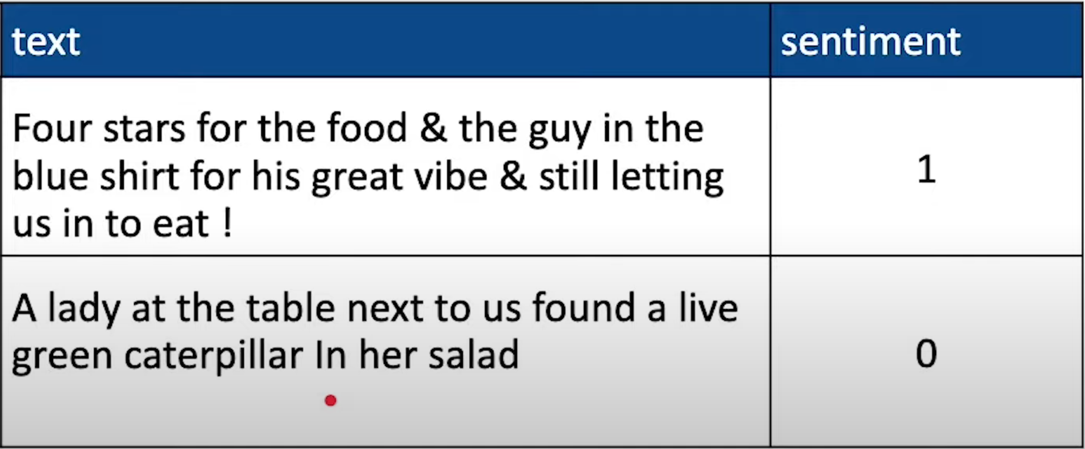
Building a Basic Sentiment Model
In our case, we’re only looking at positive vs. negative sentiment, so only a single output node is needed (0 for negative, 1 for positive). You’ll be able to use a binary cross entropy loss function since the result is only binary classification

Slide 7
Tuning the Sentiment Model
Data and preprocessing-based approaches
More data
Adjusting vocabulary size (make sure to consider the overall size of the corpus!)
Adjusting sequence length (more or less padding or truncation)
Whether to pad or truncate pre or post (usually less of an effect than the others)

Slide 8
Tuning the Sentiment Model
Model-based approaches
Adjust the number of embedding dimensions
Changing use of Flatten vs. GlobalAveragePooling1D
Considering other layers like Dropout
Adjusting the number of nodes in intermediate fully-connected layers

